Slide 1
MCP Proxy Logging

Slide 2
What is an MCP proxy?
What it is
A pass-through layer between clients and servers
Speaks MCP on both sides — looks like a server to your agent / REPL, and like a client to each backend
Sits transparently in the middle — neither side has to change
One process, one SSE endpoint, many backends behind it
What it does
Receives every JSON-RPC request from the client (tools/list, tools/call, ...)
Forwards the request to the right backend and returns the response
Captures every request and response that flows through — the camera
Aggregates many backends behind one endpoint with namespaced tool names
A natural hook point for security checks before forwarding (later)

Slide 3
How the proxy sits in the call flow
One MCP client, one proxy, multiple backends — middleware in the middle
Web
Our MCP Proxy (single Server-Sent Events (SSE) endpoint)
git server
Scoring in the future
MCP client
Local
log
filesystem server
one record per call — who called, with what arguments,
what came back, errors, timing — all in one place
time server
records every call regardless of what the server emits
The server still emits its own notifications/message — that is the narrator. The proxy is a passive camera that records every call.

Slide 4
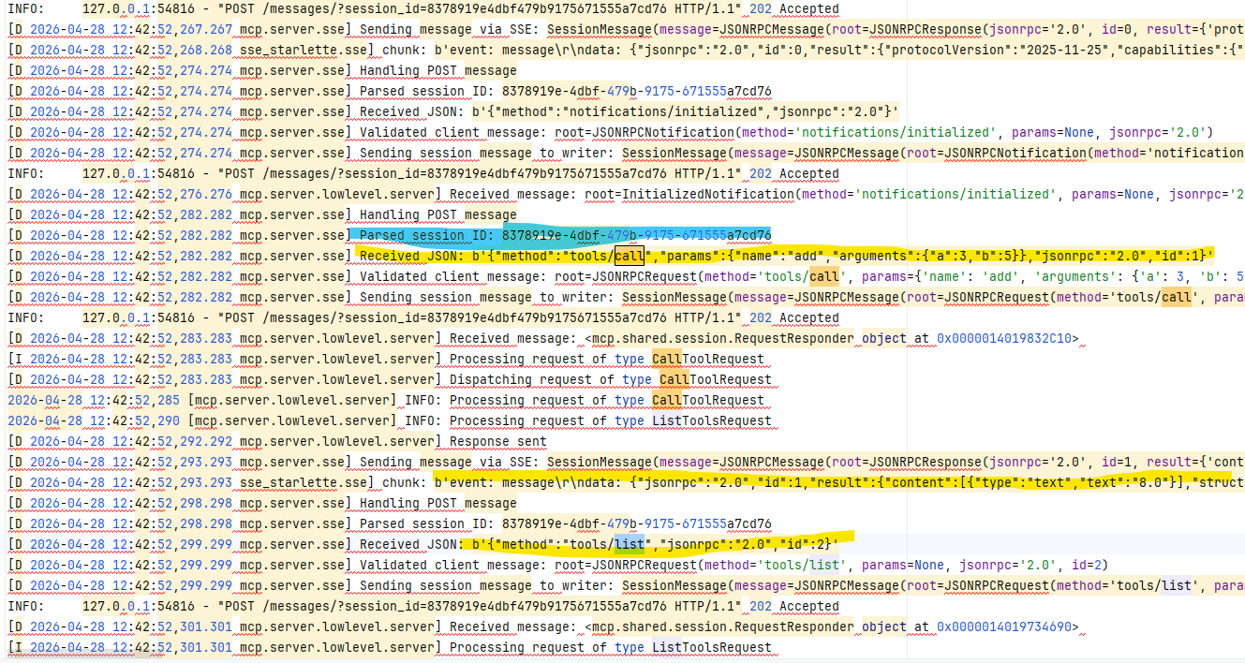
Example — what the proxy actually captures
A single audit.jsonl entry — args, response, score, timing, all together
session key
Input + tool
output

Slide 5
Next steps
What use cases we would like to simulate/emulate?
What real mcp server we would like to evaluate?

